Slide 1
Software Life Cycle
Main issues:
Discussion of different life cycle models
Maintenance or evolution
Notes:
© SE, Lifecycle, Hans van Vliet

Slide 2
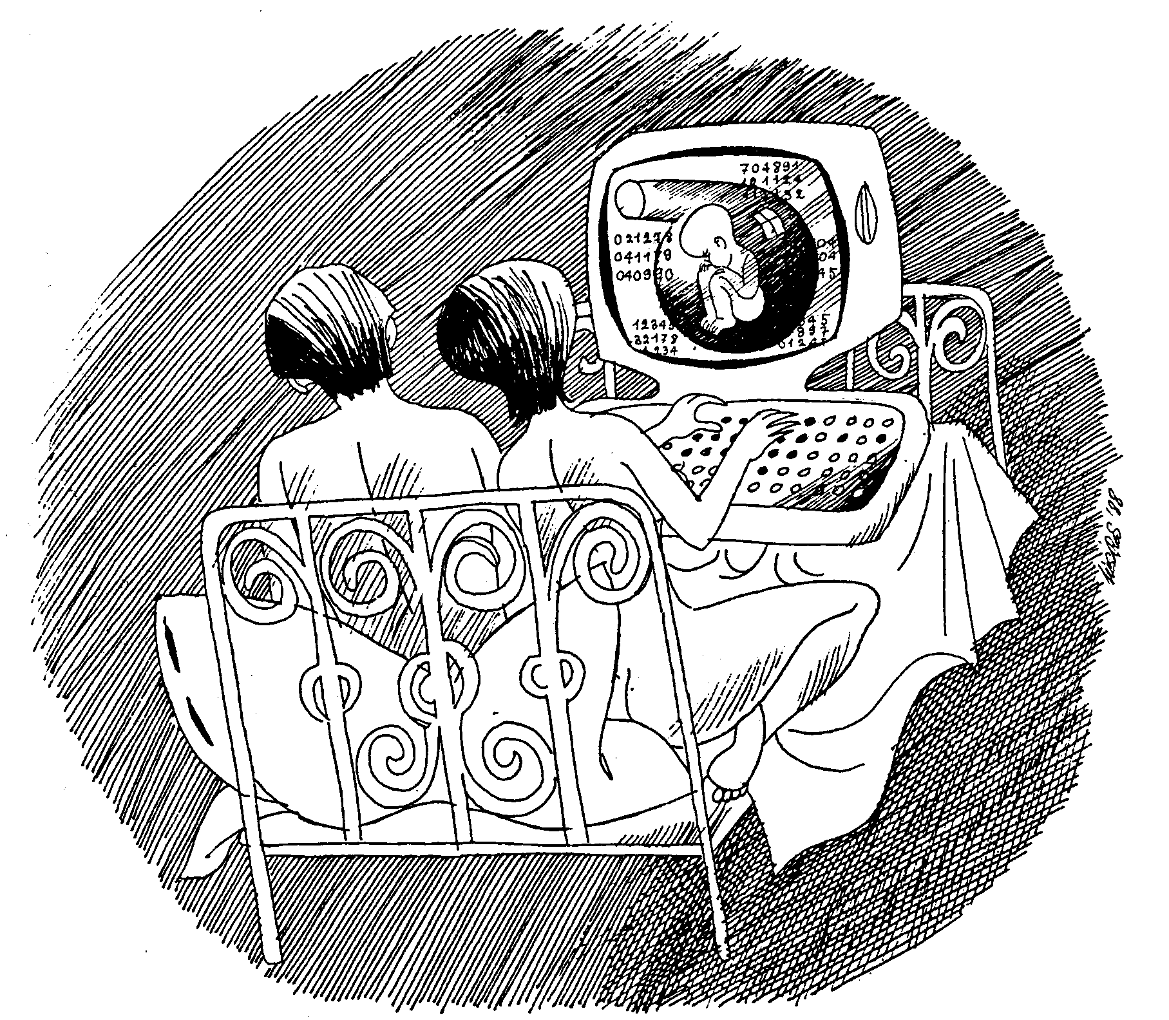
Not this life cycle
SE, Software Lifecycle, Hans van Vliet, ©2008
Notes:
© SE, Lifecycle, Hans van Vliet

Slide 3
Introduction
software development projects are large and complex
a phased approach to control it is necessary
traditional models are document-driven: there is a new pile of paper after each phase is completed
evolutionary models recognize that much of what is called maintenance is inevitable
latest fashion: agile methods, eXtreme Programming, scrum, etc.
life cycle models can be explicitly modeled, in a process modeling language
SE, Software Lifecycle, Hans van Vliet, ©2008
Notes:
© SE, Lifecycle, Hans van Vliet

Slide 4
Simple life cycle model
problem
requirements engineering
reqs specification
design
design
implementation
system
testing
working system
maintenance
SE, Software Lifecycle, Hans van Vliet, ©2008
Notes:
© SE, Lifecycle, Hans van Vliet

Slide 5
Point to ponder #1
Why does the model look like this?
Is this how we go about?
SE, Software Lifecycle, Hans van Vliet, ©2008
Notes:
© SE, Lifecycle, Hans van Vliet

Slide 6
Simple Life Cycle Model
document driven, planning driven, heavyweight
milestones are reached if the appropriate documentation is delivered (e.g., requirements specification, design specification, program, test document)
much planning upfront, often heavy contracts are signed
problems
  feedback is not taken into account
  maintenance does not imply evolution
SE, Software Lifecycle, Hans van Vliet, ©2008
Notes:
© SE, Lifecycle, Hans van Vliet
Important point to make: this is a management instrument, to control progress, rather than a development model

Slide 7
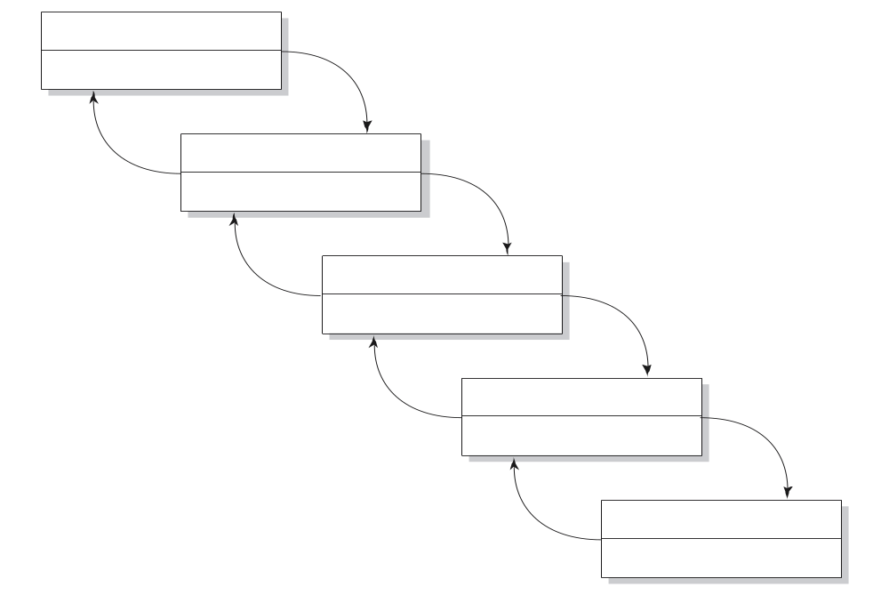
Waterfall Model
reqs engineering
V & V
design
V & V
implementation
V & V
testing
V & V
maintenance
V & V
SE, Software Lifecycle, Hans van Vliet, ©2008
Notes:
© SE, Lifecycle, Hans van Vliet
The waterfall model emphasizes iteration, caused by verification and validation steps.
This model became widely known after Boehm’s 1976 article, but goes back to the sixties.
The model is meant for salmon, not for people

Slide 8
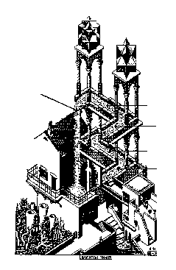
Another waterfall model （perpetual motion machine）
testing
feedback
implementation
design
requirements
engineering
SE, Software Lifecycle, Hans van Vliet, ©2008
Notes:
© SE, Lifecycle, Hans van Vliet
This is Escher’s picture from the cover

Slide 9
V-Model
reqs eng
acceptance
testing
global design
integration
testing
det. design
unit testing
coding
SE, Software Lifecycle, Hans van Vliet, ©2008

Slide 10

V-Model
SE, Software Lifecycle, Hans van Vliet, ©2008

Slide 11
Waterfall Model (cntd)
includes iteration and feedback
validation (are we building the right system? User Req.) and verification (are we building the system right? Req.) after each step
user requirements are fixed as early as possible
problems
  too rigid
  developers cannot move between various abstraction levels
SE, Software Lifecycle, Hans van Vliet, ©2008
Notes:
© SE, Lifecycle, Hans van Vliet

Slide 12
Activity versus phase
Implementation
Integration
testing
Acceptance
testing
Phase
Design
Activity
Integration
testing
4.7
43.4
26.1
25.8
Implementation
(& unit testing)
6.9
70.3
15.9
6.9
Design
49.2
34.1
10.3
6.4
SE, Software Lifecycle, Hans van Vliet, ©2008
Notes:
© SE, Lifecycle, Hans van Vliet
This is from Zelkowitz 88. The rows denote the actual activity, of designing, implementation, etc. The columns denote the (official) phases. So during the implementation phase, about 34% of the time is still spent on design.
Note the findings of Guindon: design is an opportunistic process, whereby designers hop up and down between different levels of abstraction

Slide 13

Lightweight (agile) approaches
prototyping
incremental development
RAD, DSDM
XP
Scrum
SE, Software Lifecycle, Hans van Vliet, ©2008
Notes:
© SE, Lifecycle, Hans van Vliet
XP = eXtreme Programming
DSDM = soort geformaliseerde RAD
RUP: zware methode iteratief
Open Source: beetje vreemde eend in de bijt, maar trekt veel aandacht bij de overheid

Slide 14
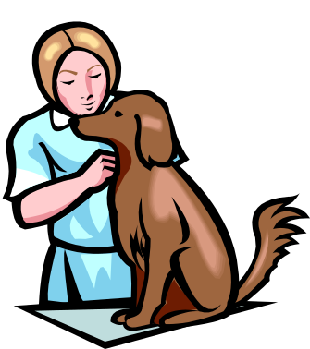
The Agile Manifesto
Individuals and interactions over processes and tools
Working software over comprehensive documentation
Customer collaboration over contract negotiation
Responding to change over following a plan
SE, Software Lifecycle, Hans van Vliet, ©2008
Notes:
© SE, Lifecycle, Hans van Vliet
Agility: readiness for motion”, “nimbleness” (= behendigheid”)

Slide 15
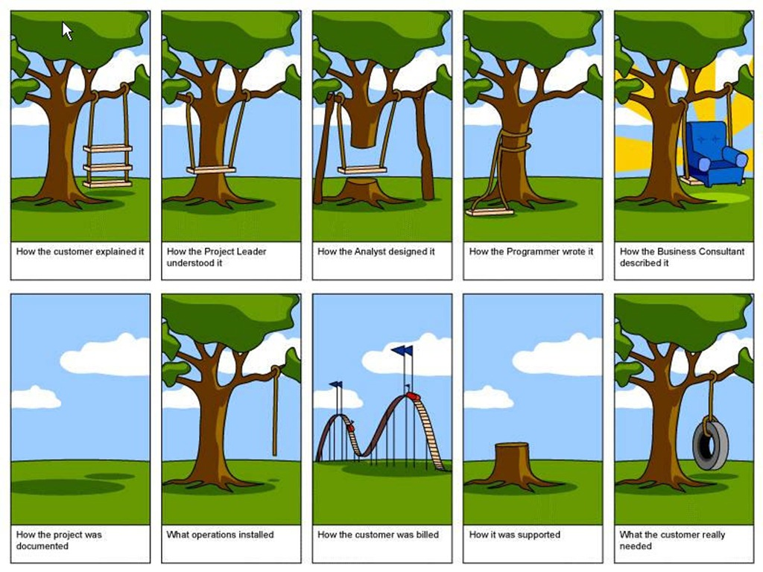
Prototyping
SE, Software Lifecycle, Hans van Vliet, ©2008
Notes:
© SE, Lifecycle, Hans van Vliet
Of the old-fashioned pushdown telephone,about 2000 prototypes were developed: with different arrangements of the keys, different sizes of the keys, different weights of the receiver, etc.

Slide 16
Prototyping
requirements elicitation is difficult
  software is developed because the present situation is unsatisfactory
  however, the desirable new situation is as yet unknown
prototyping is used to obtain the requirements of some aspects of the system
prototyping should be a relatively cheap process
  use rapid prototyping languages and tools
  not all functionality needs to be implemented
  production quality is not required
SE, Software Lifecycle, Hans van Vliet, ©2008
Notes:
© SE, Lifecycle, Hans van Vliet
Of the old-fashioned pushdown telephone,about 2000 prototypes were developed: with different arrangements of the keys, different sizes of the keys, different weights of the receiver, etc.

Slide 17
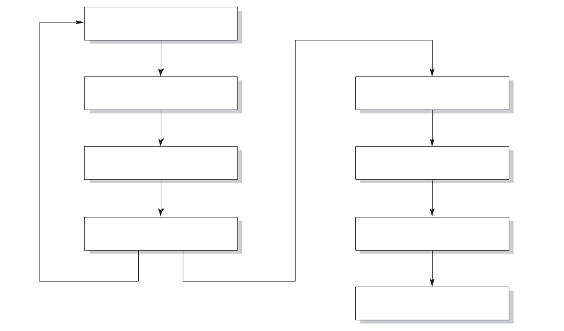
Prototyping as a tool for requirements engineering
reqs engineering
design
design
implementation
implementation
testing
testing
maintenance
SE, Software Lifecycle, Hans van Vliet, ©2008
Notes:
© SE, Lifecycle, Hans van Vliet

Slide 18
Prototyping (cntd)
throwaway prototyping: the n-th prototype is followed by a waterfall-like process (as depicted on previous slide)
evolutionary prototyping: the nth prototype is delivered
SE, Software Lifecycle, Hans van Vliet, ©2008
Notes:
© SE, Lifecycle, Hans van Vliet

Slide 19
Point to ponder #2
What are the pros and cons of the two approaches?
SE, Software Lifecycle, Hans van Vliet, ©2008
Notes:
© SE, Lifecycle, Hans van Vliet

Slide 20
Prototyping, advantages
The resulting system is easier to use
User needs are better accommodated
The resulting system has fewer features
Problems are detected earlier
The design is of higher quality
The resulting system is easier to maintain
The development incurs less effort
SE, Software Lifecycle, Hans van Vliet, ©2008
Notes:
© SE, Lifecycle, Hans van Vliet

Slide 21
Prototyping, disadvantages
The resulting system has more features
The performance of the resulting system is worse
The design is of less quality
The resulting system is harder to maintain
The prototyping approach requires more experienced team members
SE, Software Lifecycle, Hans van Vliet, ©2008
Notes:
© SE, Lifecycle, Hans van Vliet
Not that some entries on these lists are the same, I.e. some things are listed as both an advantage and as a disadvantage.

Slide 22
Prototyping, recommendations
the users and the designers must be well aware of the issues and the pitfalls
use prototyping when the requirements are unclear
prototyping needs to be planned and controlled as well
SE, Software Lifecycle, Hans van Vliet, ©2008
Notes:
© SE, Lifecycle, Hans van Vliet

Slide 23
Incremental Development
a software system is delivered in small increments, thereby avoiding the Big Bang effect
the waterfall model is employed in each phase
the user is closely involved in directing the next steps
incremental development prevents overfunctionality
SE, Software Lifecycle, Hans van Vliet, ©2008
Notes:
© SE, Lifecycle, Hans van Vliet
Overfunctionality: bells and whistles are hard to judge. In this type of process, they are postponed to the next iteration, so not developed if not really needed.

Slide 24
Discuss
Evolutionary vs Incremental
SE, Software Lifecycle, Hans van Vliet, ©2008
Notes:
© SE, Lifecycle, Hans van Vliet
Overfunctionality: bells and whistles are hard to judge. In this type of process, they are postponed to the next iteration, so not developed if not really needed.

Slide 25
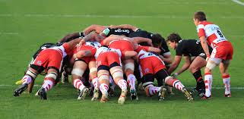
Scrum
SE, Software Lifecycle, Hans van Vliet, ©2008
Notes:
© SE, Lifecycle, Hans van Vliet

Slide 26
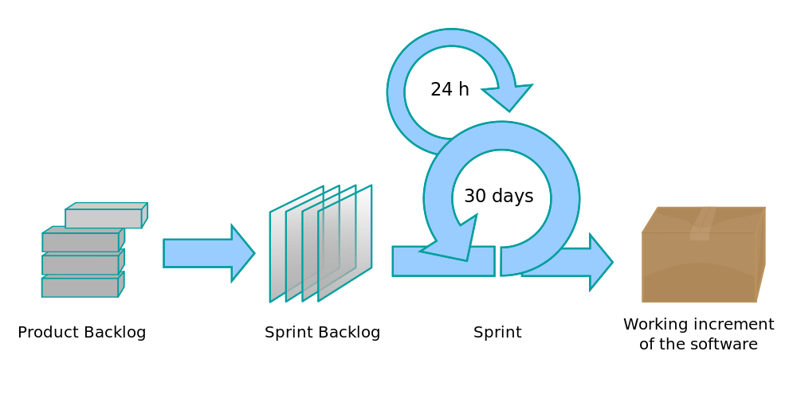
Scrum
SE, Software Lifecycle, Hans van Vliet, ©2008
Notes:
© SE, Lifecycle, Hans van Vliet

Slide 27
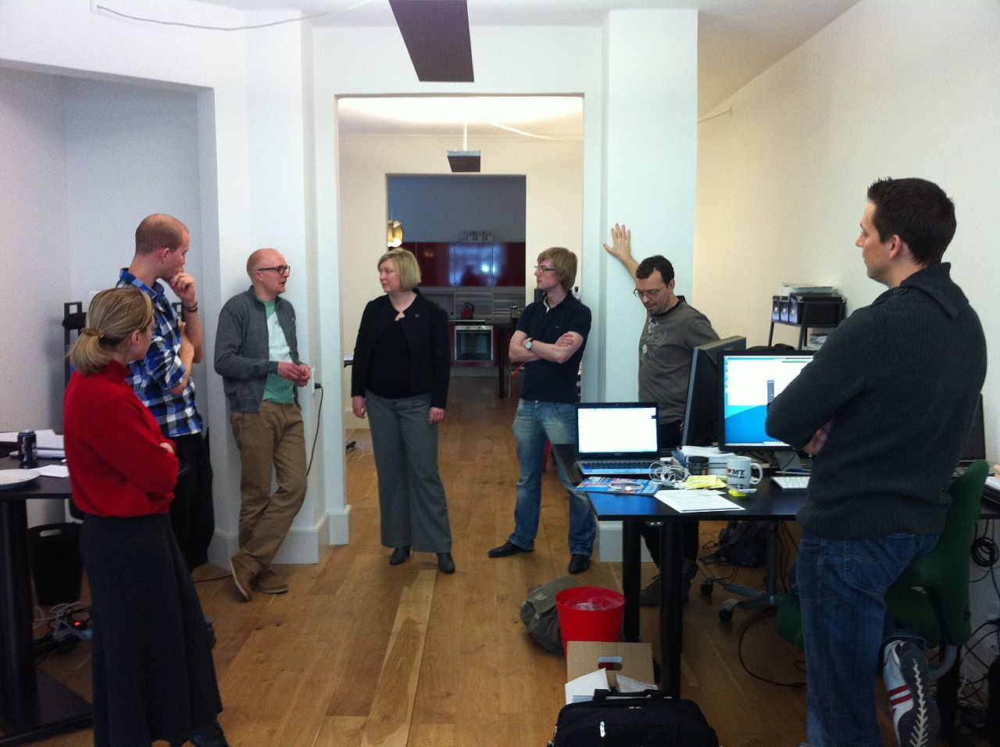
Scrum
SE, Software Lifecycle, Hans van Vliet, ©2008
Notes:
© SE, Lifecycle, Hans van Vliet

Slide 28
Scrum
Originally proposed by Schwaber and Beedle
Scrum—distinguishing features
  Development work is partitioned into “packets”
  Testing and documentation are on-going as the product is constructed
  Work occurs in “sprints” (no change) and is derived from a “backlog” (can change) of existing requirements
SE, Software Lifecycle, Hans van Vliet, ©2008
Notes:
© SE, Lifecycle, Hans van Vliet

Slide 29
Scrum
  Meetings are very short and sometimes conducted without chairs. Scrum master leads for three key questions.
    What did you do since the last team meeting?
    What obstacles are you encountering?”
    What do you plan to accomplish by the next team meeting?
  “demos” are delivered to the customer with the time-box allocated
SE, Software Lifecycle, Hans van Vliet, ©2008
Notes:
© SE, Lifecycle, Hans van Vliet

Slide 30
Scrum
https://www.scrum.org/
http://www.agilealliance.org/
SE, Software Lifecycle, Hans van Vliet, ©2008
Notes:
© SE, Lifecycle, Hans van Vliet

Slide 31
XP – eXtreme Programming
Everything is done in small steps
The system always compiles, always runs
Client as the center of development team
Developers have same responsibility w.r.t. software and methodology
SE, Software Lifecycle, Hans van Vliet, ©2008
Notes:
© SE, Lifecycle, Hans van Vliet
Ontstaan zo rond 1998. Maar bouwt naturlijk wel voort op eerdere ontwikkelingen: AD, evolutionair ontwikkelen ed, spiraal model, scandinavische school, fysische omgeving programmeurs, zoals onderzocht bij bv IBM (telefoon uit)

Slide 32

XP – eXtreme Programming
SE, Software Lifecycle, Hans van Vliet, ©2008
Notes:
© SE, Lifecycle, Hans van Vliet
Ontstaan zo rond 1998. Maar bouwt naturlijk wel voort op eerdere ontwikkelingen: AD, evolutionair ontwikkelen ed, spiraal model, scandinavische school, fysische omgeving programmeurs, zoals onderzocht bij bv IBM (telefoon uit)

Slide 33
XP – eXtreme Programming
The most widely used agile process, originally proposed by Kent Beck worked on the Chrysler Comprehensive Compensation System (C3) payroll project.
XP Planning
  Begins with the creation of “user stories”
  Agile team assesses each story and assigns a cost
  Stories are grouped to for a deliverable increment
  A commitment is made on delivery date
  40 hour week
  After the first increment “project velocity” is used to help define subsequent delivery dates for other increments
SE, Software Lifecycle, Hans van Vliet, ©2008
Notes:
© SE, Lifecycle, Hans van Vliet
Ontstaan zo rond 1998. Maar bouwt naturlijk wel voort op eerdere ontwikkelingen: AD, evolutionair ontwikkelen ed, spiraal model, scandinavische school, fysische omgeving programmeurs, zoals onderzocht bij bv IBM (telefoon uit)

Slide 34
XP – eXtreme Programming
XP Design
  Follows the KISS principle (Keep It Simple, Stupid, US Navy, 1960)
  Encourage the use of CRC cards (Class Responsibility Collaborator)
  For difficult design problems, suggests the creation of “spike solutions”—a design prototype
  Metaphor
  Encourages “refactoring”—an iterative refinement of the internal program design
XP Coding
  Recommends the construction of a unit test for a store before coding commences
  Encourages “pair programming”
  Collective Ownership
XP Testing
  All unit tests are executed daily
  Regression testing.
  “Acceptance tests” are defined by the customer and executed to assess customer visible functionality
SE, Software Lifecycle, Hans van Vliet, ©2008
Notes:
© SE, Lifecycle, Hans van Vliet
Ontstaan zo rond 1998. Maar bouwt naturlijk wel voort op eerdere ontwikkelingen: AD, evolutionair ontwikkelen ed, spiraal model, scandinavische school, fysische omgeving programmeurs, zoals onderzocht bij bv IBM (telefoon uit)

Slide 35
Industrial XP (IXP)
IXP has greater inclusion of management, expanded customer roles, and upgraded technical practices
IXP incorporates six new practices:
  Readiness assessment – people, environment, skill level
  Project community – right people, right skill, training
  Project chartering – justification
  Test driven management – measurable destinations
  Retrospectives – technical review
  Continuous learning – new method and techniques
SE, Software Lifecycle, Hans van Vliet, ©2008
Notes:
© SE, Lifecycle, Hans van Vliet
Ontstaan zo rond 1998. Maar bouwt naturlijk wel voort op eerdere ontwikkelingen: AD, evolutionair ontwikkelen ed, spiraal model, scandinavische school, fysische omgeving programmeurs, zoals onderzocht bij bv IBM (telefoon uit)

Slide 36
13 practices of XP
Whole team: client part of the team
Metaphor: common analogy for the system
The planning game, based on user stories
Simple design
Small releases (e.g. 2 weeks)
Customer tests
Pair programming
Test-driven development: tests developed first
Design improvement (refactoring)
Collective code ownership
Continuous integration: system always runs
Sustainable pace: no overtime
Coding standards
SE, Software Lifecycle, Hans van Vliet, ©2008
Notes:
© SE, Lifecycle, Hans van Vliet
Voraf wel korte vorbereiding, met beetje architectuur, maar niet echt veel.
Team zonder bazen, met client er midden in
Metafoor: desktop bv.
Planning gebaseerd op scenarios, en soort “kunst”maat: bv story kost 4 bLUBS. En deze week maken we 20 BLUBS. Aan het eind van de week kijken of dat klopt, en je idee van de omvang van een BLUB bijstellen.
In design alleen stoppen wat je nodig hebt; de wereld verandert toch; aardige metFOO HIER: ELKE DAG KAART OPZETTEN EN WEER VOORSPELLEN, IPV EEN KEER PER WEEK.
Client evalueert elke release, en stelt zonodig bij; bepaalt prioriteiten volgende stories, etc.
Pair programming: piloot en copiloot; je kunt het van elkaar overnemen, enz.
Ipv eerst code schrijven, schrijf je eerst de tests
Overwerk leidt tot burnout, fouten, meer overwerk.
Team neemt een of andere standaard aan.

Slide 37
RAD: Rapid Application Development
Life Cycle
  Requirement Planning
  Application Design
  Construction
  Cutover
SE, Software Lifecycle, Hans van Vliet, ©2008
Notes:
© SE, Lifecycle, Hans van Vliet
Triage: split requirements in 3 sets: to be done now, to be done later, and things that will be done now if time permits it.
SWAT teams are discussed in chapter 5 as well, a bit.
RAD has much in common with the Scandinavian school, because they both value the role of users in the development process.

Slide 38
RAD: Rapid Application Development
Evolutionary development, with time boxes: fixed time frames within which activities are done;
Time frame is decided upon first, then one tries to realize as much as possible within that time frame;
Other elements: Joint Requirements Planning (JRP) and Joint Application Design (JAD), workshops in which users participate; Participatory Design (PD) or Scandinavian school of software development.
SE, Software Lifecycle, Hans van Vliet, ©2008
Notes:
© SE, Lifecycle, Hans van Vliet
Triage: split requirements in 3 sets: to be done now, to be done later, and things that will be done now if time permits it.
SWAT teams are discussed in chapter 5 as well, a bit.
RAD has much in common with the Scandinavian school, because they both value the role of users in the development process.

Slide 39
RAD: Rapid Application Development
Requirements prioritization through a triage -> MoSCoW;
Development in a SWAT team: Skilled Workers with Advanced Tools
  < 2 months
  Time frame not exceeded, sacrificed functionality
Who decide the time box?
SE, Software Lifecycle, Hans van Vliet, ©2008
Notes:
© SE, Lifecycle, Hans van Vliet
Triage: split requirements in 3 sets: to be done now, to be done later, and things that will be done now if time permits it.
SWAT teams are discussed in chapter 5 as well, a bit.
RAD has much in common with the Scandinavian school, because they both value the role of users in the development process.

Slide 40
DSDM
Dynamic Systems Development Method, #1 RAD framework in UK (www.dsdm.org)
Fundamental idea: fix time and resources (timebox), adjust functionality accordingly
One needs to be a member of the DSDM consortium to access the complete set of DSDM practices.
SE, Software Lifecycle, Hans van Vliet, ©2008
Notes:
© SE, Lifecycle, Hans van Vliet

Slide 41
DSDM phases
Feasibility: delivers feasibility report and outline plan, optionally fast prototype (few weeks)
Business study: analyze characteristics of business and technology (in workshops), delivers System Architecture Definition
Functional model iteration: timeboxed iterative, incremental phase, yields requirements (what, how, do, check) (2-6 weeks)
Design and build iteration (2-6 weeks)
Implementation: transfer to production environment
SE, Software Lifecycle, Hans van Vliet, ©2008
Notes:
© SE, Lifecycle, Hans van Vliet

Slide 42
DSDM practices
Active user involvement is imperative
Empowered teams
Frequent delivery of products
Acceptance determined by fitness for business purpose
Iterative, incremental development
All changes are reversible
Requirements baselined at high level
Testing integrated in life cycle
Collaborative, cooperative approach shared by all stakeholders is essential
SE, Software Lifecycle, Hans van Vliet, ©2008
Notes:
© SE, Lifecycle, Hans van Vliet

Slide 43
RUP
Rational Unified Process, document driven/agile
Complement to UML (Unified Modeling Language)
Iterative approach for object-oriented systems, strongly embraces use cases for modeling requirements
Tool-supported (UML-tools, ClearCase)
SE, Software Lifecycle, Hans van Vliet, ©2008
Notes:
© SE, Lifecycle, Hans van Vliet

Slide 44
RUP phases
Inception: establish scope, boundaries, critical use cases, candidate architectures, schedule and cost estimates
Elaboration: foundation of architecture, establish tool support, get all use cases
Construction: manufacturing process, one or more releases
Transition: release to user community, often several releases
SE, Software Lifecycle, Hans van Vliet, ©2008
Notes:
© SE, Lifecycle, Hans van Vliet

Slide 45
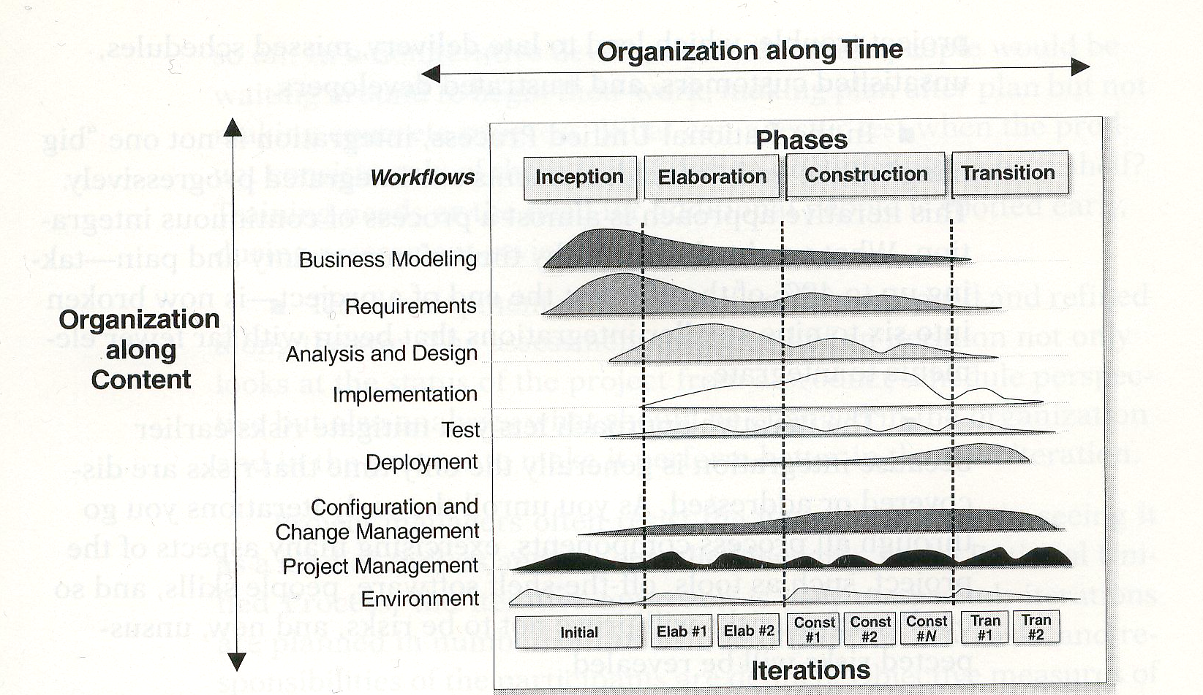
Two-dimensional process structure of RUP
SE, Software Lifecycle, Hans van Vliet, ©2008
Notes:
© SE, Lifecycle, Hans van Vliet

Slide 46
Differences for developers
Agile: knowledgeable, collocated, collaborative
Heavyweight: plan-driven, adequate skills, access to external knowledge
SE, Software Lifecycle, Hans van Vliet, ©2008
Notes:
© SE, Lifecycle, Hans van Vliet
Volgende reeks slides geven aantal globale verschillen aan

Slide 47
Differences for customers
Agile: dedicated, knowledgeable, collocated, collaborative, representative, empowered
Heavyweight: access to knowledgeable, collaborative, representative, empowered customers
SE, Software Lifecycle, Hans van Vliet, ©2008
Notes:
© SE, Lifecycle, Hans van Vliet
Bij de laatste: dat hoop je maar; defensie voorbeeld van Gerrit

Slide 48
Differences for requirements
Agile: largely emergent, rapid change
Heavyweight: knowable early, largely stable
SE, Software Lifecycle, Hans van Vliet, ©2008
Notes:
© SE, Lifecycle, Hans van Vliet

Slide 49
Differences for architecture
Agile: designed for current requirements
Heavyweight: designed for current and foreseeable requirements
SE, Software Lifecycle, Hans van Vliet, ©2008
Notes:
© SE, Lifecycle, Hans van Vliet

Slide 50
Differences for size
Agile: smaller teams and products
Heavyweight: larger teams and products
SE, Software Lifecycle, Hans van Vliet, ©2008
Notes:
© SE, Lifecycle, Hans van Vliet

Slide 51
Differences for primary objective
Agile: rapid value
Heavyweight: high assurance
SE, Software Lifecycle, Hans van Vliet, ©2008
Notes:
© SE, Lifecycle, Hans van Vliet

Slide 52

The advantages of screen wipers
SE, Software Lifecycle, Hans van Vliet, ©2008
Notes:
© SE, Lifecycle, Hans van Vliet
A funny story, about the importance to prepare oneself for a maintenance phase.
In communist Russia, factories had to produce a certain number of cars per month. So everything was done to fulfill this requirement. No one required them to produce spare parts as well, and so they didn’t. Spare parts thus became a scarce commodity. Also spare screen wipers. So people removed these from their cars, to prevent them from being stolen, and put them back on when it started to rain.

Slide 53
MDA – Model Driven Architecture
model
model
maintenance
transformation
implementation
code
code
maintenance
SE, Software Lifecycle, Hans van Vliet, ©2008
Notes:
© SE, Lifecycle, Hans van Vliet
First termed MDD: Model-Driven Development: much better name, but the acronym already existed.

Slide 54
Essence of MDA
Platform Independent Model (PIM)
Model transformation and refinement
Resulting in a Platform Specific Model (PSM)
SE, Software Lifecycle, Hans van Vliet, ©2008
Notes:
© SE, Lifecycle, Hans van Vliet
Platform is e.g. .NET, CORBA, hardware topology, etc.
One can then define a transformation (refinement) from the PIM to one or more platform specific models. E.g. Java,

Slide 55
Maintenance or Evolution
some observations
  systems are not built from scratch
  there is time pressure on maintenance
the five laws of software evolution
  law of continuing change
  law of increasingly complexity
  law of program evolution
  law of invariant work rate
  law of incremental growth limit
SE, Software Lifecycle, Hans van Vliet, ©2008
Notes:
© SE, Lifecycle, Hans van Vliet
So there is a gradual difference between development and evolution, where the emphasis is on different things. A green field situation is seldom found in software development.
So: design for change;
continuing change: if a system is used, it changes, until it becomes cost-effective to replace the whole system
increasing complexity: entropy increases
program evolution: growth rate is self-regulating (see next slide)
invariant work rate: a few extra people don’t make a big difference (Brooks Law, see also chapter 7)
incremental growth limit: system “determines” its own growth rate, if you go too fast, you get into trouble
Explanation in terms of progressive and anti-regressive activities

Slide 56
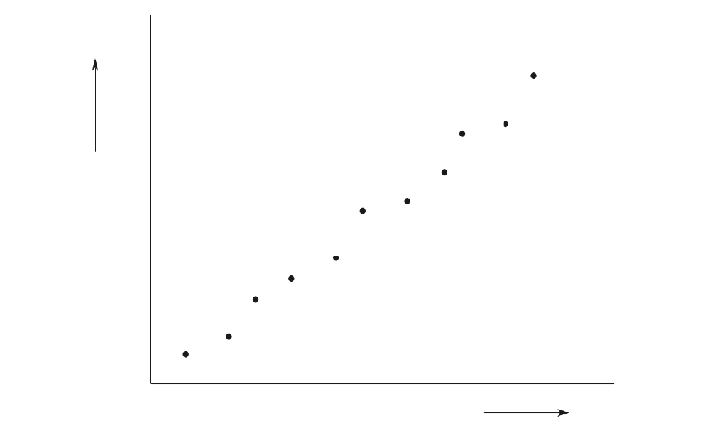
Illustration third law of Software Evolution
system
attributes
time
SE, Software Lifecycle, Hans van Vliet, ©2008
Notes:
© SE, Lifecycle, Hans van Vliet
The line is almost straight. The regular hops can be explained as follows: for a while, as many user wishes as possible are implemented. This increases functionality/size/function points/number of modules more than linearly. Then the team gets into trouble, and has to go slower: first, the structure of the system has to be taken care of, documentation has to be updated etc.
So Conclusion:
be alert during maintenance:it is a balancing act between adding new features and securing the future;
periods with a progressive focus are followed by periods with an anti-regressive focus.
software is not built, it grows

Slide 57
Software Product Lines
developers are not inclined to make a maintainable and reusable product, it has additional costs
this viewpoint is changed somewhat if the product family is the focus of attention rather than producing a single version of a product
two processes result: domain engineering, and application engineering
SE, Software Lifecycle, Hans van Vliet, ©2008
Notes:
© SE, Lifecycle, Hans van Vliet

Slide 58
Process modeling
we may describe a software-development process, or parts thereof, in the form of a “program” too. E.G.:
  function review(document, threshold): boolean;
  begin prepare-review;
  hold-review{document, no-of-problems);
  make-report;
  return no-of-problems < threshold
  end review;
SE, Software Lifecycle, Hans van Vliet, ©2008
Notes:
© SE, Lifecycle, Hans van Vliet
Here, the review process is described in terms of the activities that have to be done

Slide 59
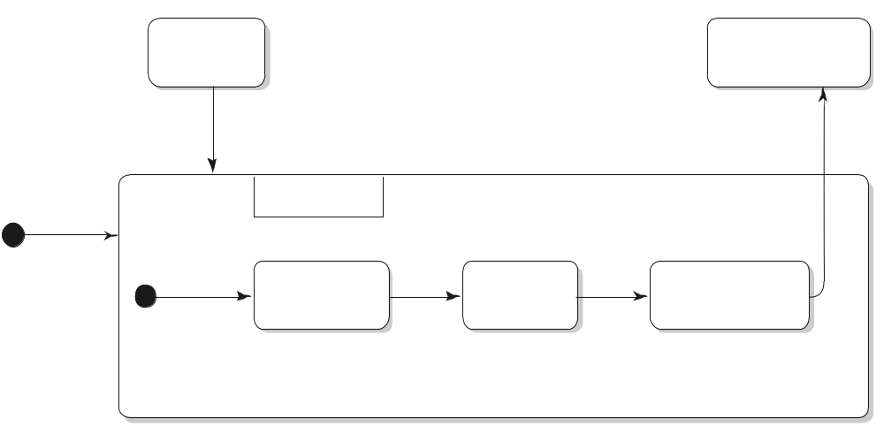
STD of review process
coding
ready
ready for
next step
submit
re-review
review
prepare
do
make
ready
done
report ready
report
SE, Software Lifecycle, Hans van Vliet, ©2008
Notes:
© SE, Lifecycle, Hans van Vliet
This is the same review process, but now emphasis is on the states, and state transitions.
This figures uses the UML notation for state diagrams

Slide 60
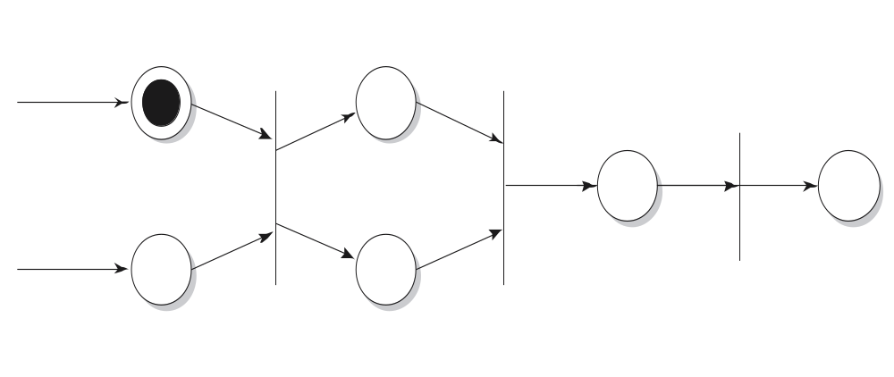
Petri-net view of the review process
code
ready
hold
review
code
update
from
revised
code
end
next
step
coding
from
management
scheduled
minutes
SE, Software Lifecycle, Hans van Vliet, ©2008
Notes:
© SE, Lifecycle, Hans van Vliet
Petri nets allow for the modeling of nondeterminism and parallellism.
Petri nets have places (the circles), which are either marked or unmarked. A transition if a vertical line. Transitions have inputs and outputs, the arrows.
If all input paces to a transition are marked, in may “fire”. All marks are then removed form the input places, and all output places are marked.
So, in the above exmple, the review can only be held if the code is ready for review, and management has scheduled the review.

Slide 61
Purposes of process modeling
facilitates understanding and communication by providing a shared view of the process
supports management and improvement; it can be used to assign tasks, track progress, and identify trouble spots
serves as a basis for automated support (usually not fully automatic)
SE, Software Lifecycle, Hans van Vliet, ©2008
Notes:
© SE, Lifecycle, Hans van Vliet
For example, the Petri-net type of models can be used to drive the review process, whereby testers automatically get a warning when certain code is ready, managers get information about testing time, number of bugs found, etc.

Slide 62
Caveats of process modeling
not all aspects of software development can be caught in an algorithm
a model is a model, thus a simplification of reality
progression of stages differs from what is actually done
some processes (e.g. learning the domain) tend to be ignored
no support for transfer across projects
SE, Software Lifecycle, Hans van Vliet, ©2008
Notes:
© SE, Lifecycle, Hans van Vliet
So what tends to be modeled are the “easy” parts.
As for stages versus what is really done, see earlier slide with the numbers from Zelkowitz.

Slide 63
Summary
Traditional models focus on control of the process
There is no one-size-fits-all model; each situation requires its own approach
A pure project approach inhibits reuse and maintenance
There has been quite some attention for process modeling, and tools based on such process models
SE, Software Lifecycle, Hans van Vliet, ©2008

